Slide 1
Lab 8
Socket Programming with UDP
TA：Yung-Tung Chou
Professor：Hsung-Pin Chang
Operating System Lab

Slide 2
Outline
Socket
Socket API
Socket Example
Exercise

Slide 3
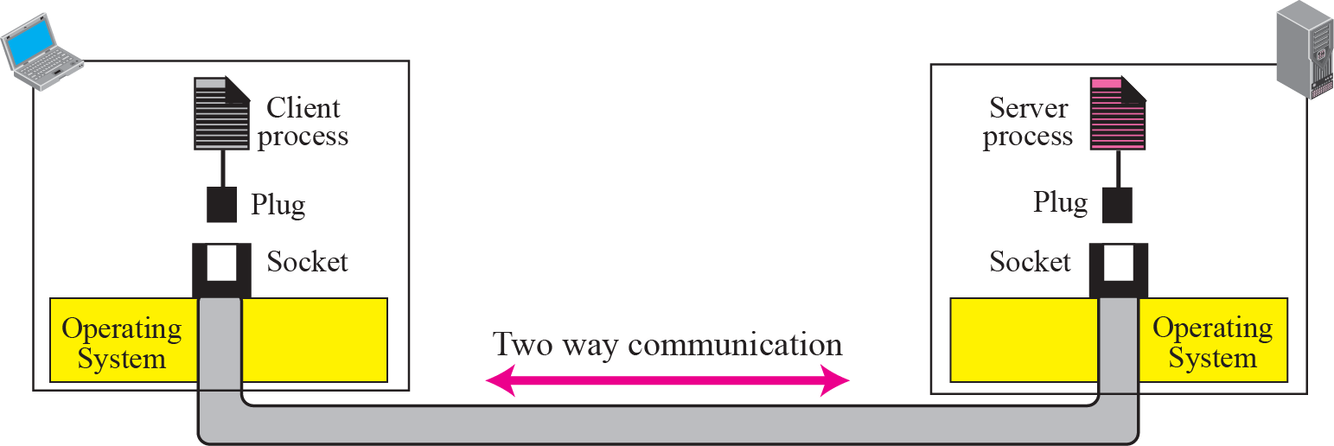
The definition of socket
It was first developed at the University of California, Berkeley for use on Unix systems
  Berkeley socket
All modern operating systems now have some implementation of the Berkeley socket interface
  Became the standard interface for connecting to the Internet
To allow communications between hosts or between processes on one computer
Notes:
Socket最早是由美國加州柏克萊大學所發展，所以又稱為柏克萊 socket，在現在的系統上，已經把socket 寫作一套library， 讓使用者去直接使用，我們就直接叫他做bSI，使用者只要負責call 這些socket api，而不需要再去接觸更底層的物件，這張圖是在說明如何建立連結傳輸資料

Slide 4
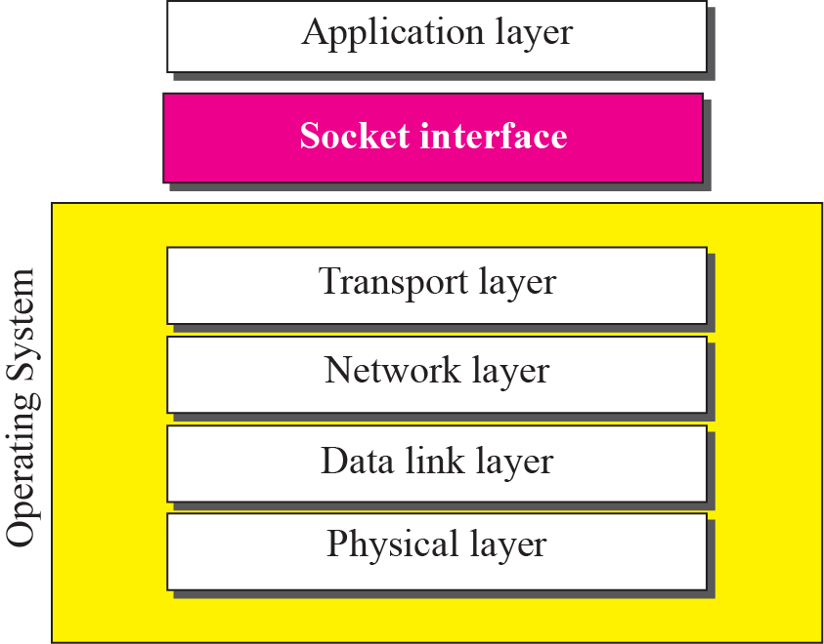
The definition of socket(Cont.)
Relation between the operating system and the TCP/IP suite

Slide 5
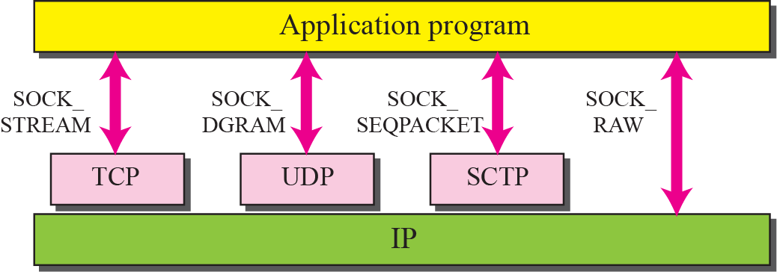
The definition of socket(Cont.)
Notes:
TCP傳輸較安全，可靠性較高，但傳輸比較慢，比較適合大量或重要的資料傳輸

Slide 6
Outline
Socket
Socket API
Socket Example
Exercise

Slide 7
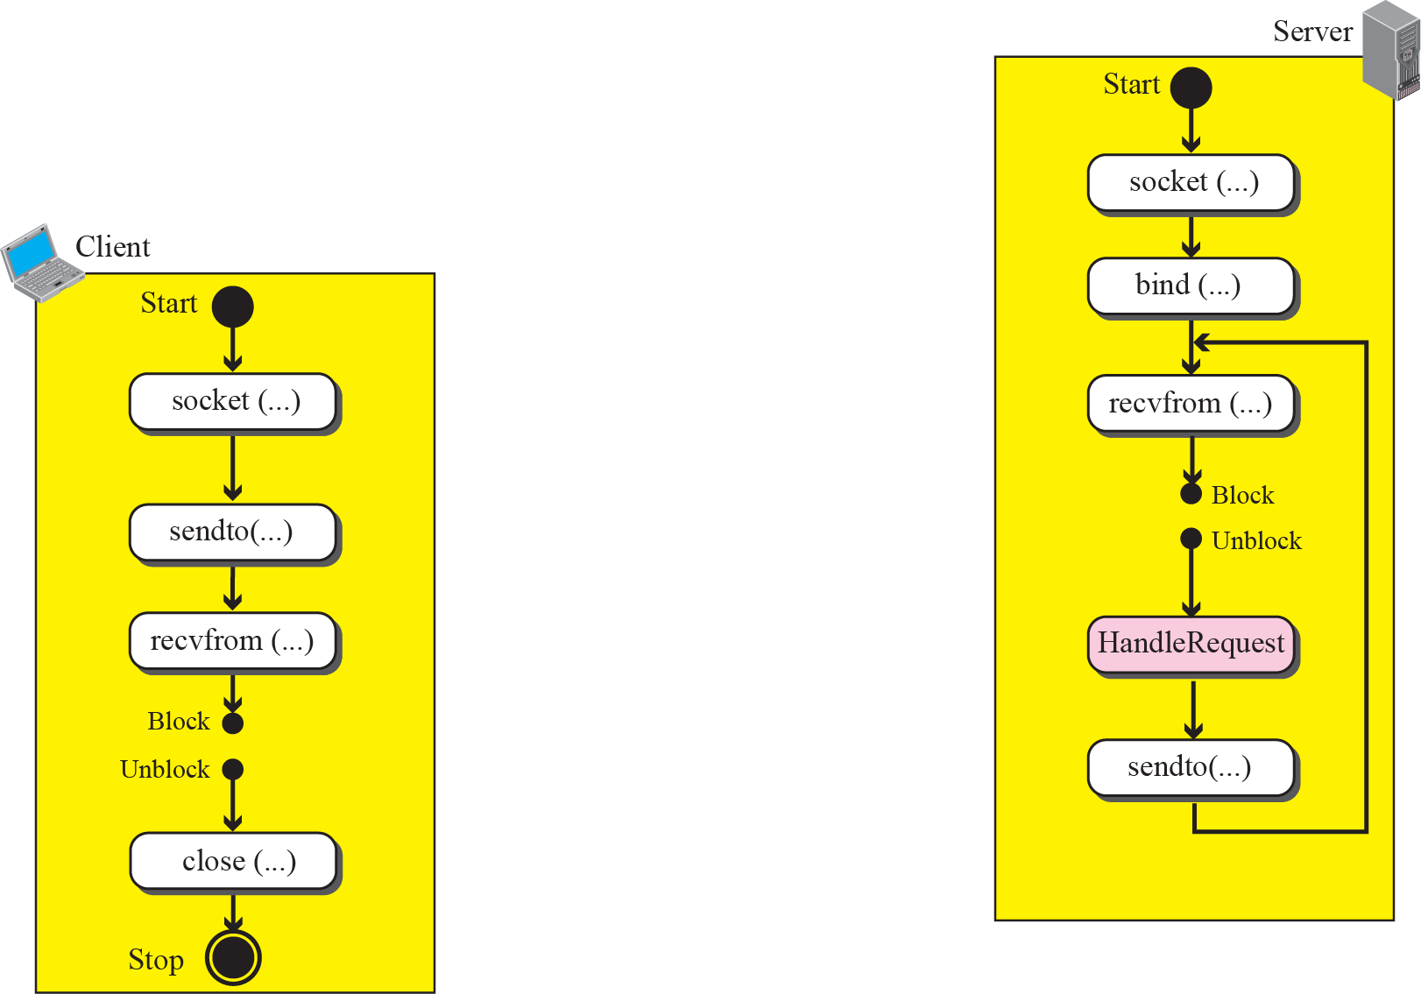
Socket API (UDP)
Connectionless iterative communication using UDP

Slide 8
Socket API (UDP)
socket
  Create a descriptor for use in network communication
#include <sys/type.h>
#include <sys/socket.h>
int socket(int domain, int type, int protocol);
EX: sock = socket(PF_INET, SOCK_DGRAM, 0);
domain:
PF_UNIX: Protocol Family is UNIX
(for local communication)
PF_INET: Protocol Family is IPv4
PF_INET6:Protocol Family is IPv6
type:
SOCK_STREAM: TCP
SOCK_DGRAM: UDP
SOCK_SEQPACKET: SCTP
SOCK_RAW
protocol:
0 ~ 255
  (ref. /etc/protocols. The value 0 may be used to select a default protocol from the selected domain and type)
return value:
successful:
    return a non-negative integer, socket descriptor (sd)
otherwise return -1

Slide 9
Socket API (cont.)
htons
  Convert the unsigned short integer host short from host byte order to network byte order
Byte order
  Little endian
  Big endian
#include <arpa/inet.h>
uint16_t htons(uint16_t hostshort);
EX: address.sin_port = htons(5555);

Slide 10
Socket API (cont.)
bzero
  Set the first n bytes of the area starting at s to zero (bytes containing '\0')
inet_addr
  Convert the Internet host address cp from IPv4 numbers-and-dots notation into binary data in network byte order
#include <string.h>
void bzero(char *s, int n);
EX: bzero(&Address, sizeof(Address));
#include <sys/socket.h>
#include <netinet/in.h>
#include <arpa/inet.h>
in_addr_t inet_addr(const char *cp);
EX: address.sin_addr.s_addr = inet_addr(“140.120.15.242”);

Slide 11
Socket API (cont.)
bind
  Bind a local IP address and protocol port to a socket
#include <sys/socket.h>
#include <netinet/in.h>
int bind(int sd, struct sockaddr *address, int address_length);
EX:
struct sockaddr_in Address;
bind(sock,(struct sockaddr *)&Address, sizeof(Address))

Slide 12
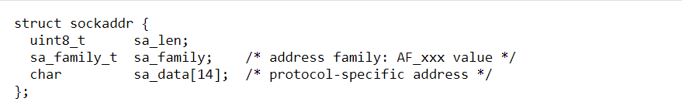
Socket API (cont.)
Generic Socket Address Structure - sockaddr
  Define a generic socket address structure in the <sys/socket.h> header

Slide 13
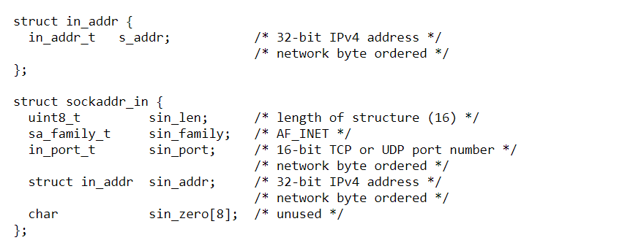
Socket API (cont.)
IPv4 Socket Address Structure
  However, each supported protocol suite defines its own socket address structure
  The names of these structures begin with sockaddr_ and end with a suffix for each protocol suite
  An IPv4 socket address structure, commonly called an "Internet socket address structure," is named sockaddr_in and is defined by including the <netinet/in.h> header

Slide 14
Socket API (UDP)
  AF_xxx Versus PF_xxx
    The "PF_" prefix stands for "protocol family“ and the "AF_" prefix stands for "address family“
    The PF_ value was computer network programming used to create the socket, and thus used in calling socket() function
    The AF_ value was used in socket address structures, and used in calling bind() function

Slide 15
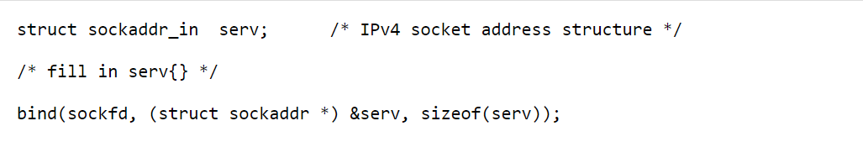
Socket API (cont.)
Generic Socket Address Structure & protocol-specific socket address structure
  In calling bind(), we need to pass a Generic Socket Address Structure argument
  However, each supported protocol suite defines its own socket address structure (like IPv4 Socket Address Structure)
  Thus, this requires that any calls to bind() must cast the pointer to the protocol-specific socket address structure to be a pointer to a generic socket address structure
  For example,

Slide 16
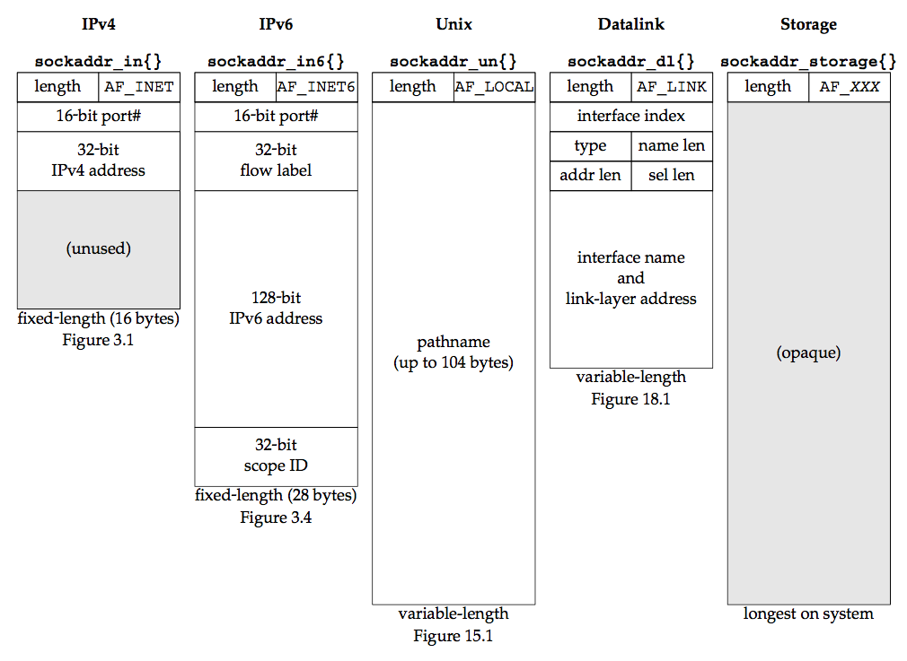
Socket API (cont.)
Comparison of Socket Address Structures

Slide 17
Socket API (cont.)
For UDP
recvfrom
  Receive a message from a socket
sendto
  Send a message on a socket
#include <sys/socket.h>
int recvfrom(int sd, void *buffer, int message_length, int flags,
struct sockaddr *address, int *address_length);
EX: byte_recv = recvfrom(sock, buffer, sizeof(buffer), 0, (struct sockaddr *)&Address, &sizeof(Address));
#include <sys/socket.h>
int sendto(int sd, void *buffer, int message_length, int flags,
struct sockaddr *address, int address_length);
EX: byte_sent = sendto(sock, buffer, sizeof(buffer), 0, (struct sockaddr *)&Address, sizeof(Address));

Slide 18
Outline
Socket
Socket API
Socket Example
Exercise

Slide 19
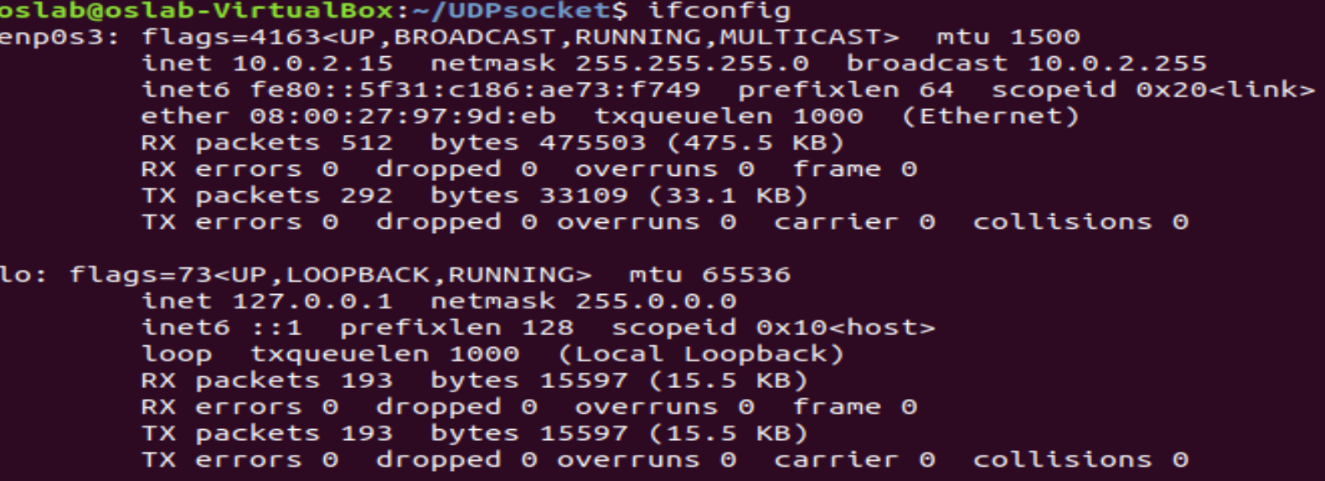
How to check your ip
Type: ifconfig

Slide 20
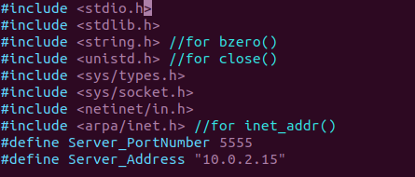
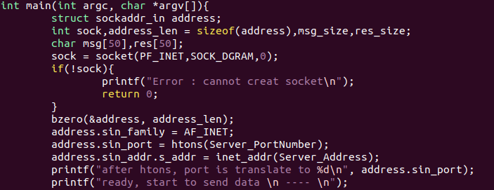
Socket Example
Using UDP - Client

Slide 21
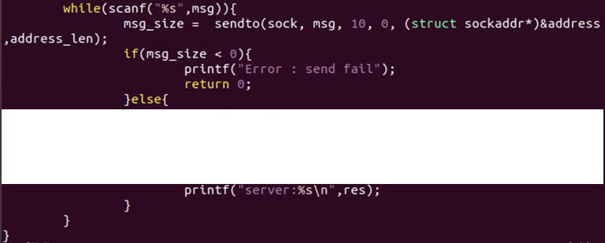
Socket Example
Using UDP - Client

Slide 22
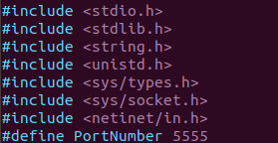
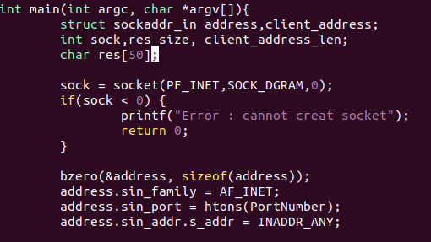
Socket Example (cont.)
Using UDP - Server

Slide 23
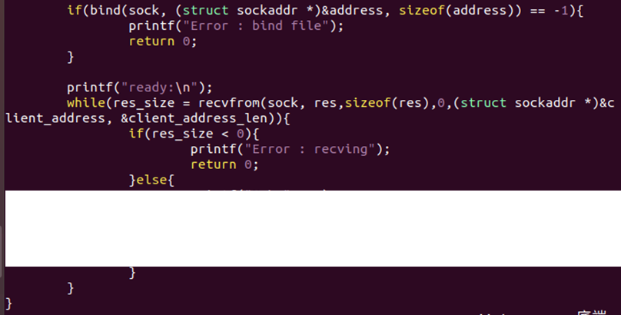
Socket Example (cont.)
Using UDP - Server

Slide 24
Outline
Socket
Socket API
Socket Example
Exercise

Slide 25
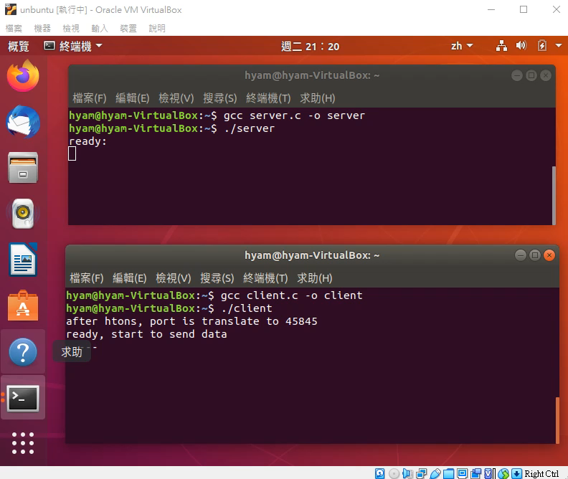
Exercises
UDP Socket Programming: send/receive UDP packets. [90 pt]

